Slide 1

Answer: 6 in 10 Australians said they are. (Source: Michael Page studies- “Make 2022 the Year of Opportunities)
When COVID happened, have you had a thought of changing careers? Are you planning to make a move in the next 6 months?
Impact of COVID on Australian Employment

Slide 2
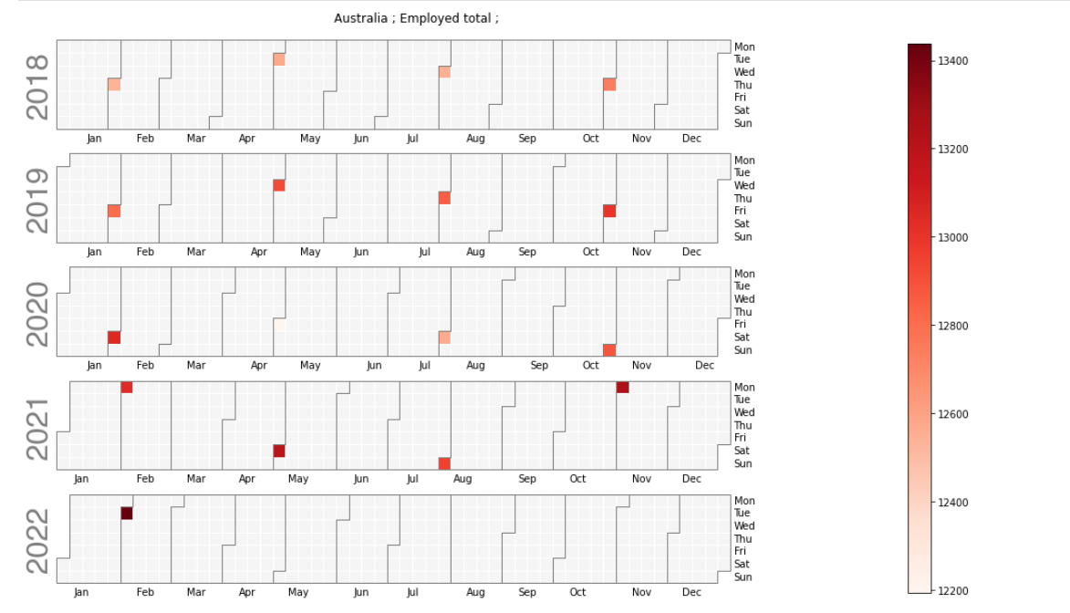
Overall Employment in Australia (Qtly)

Slide 3
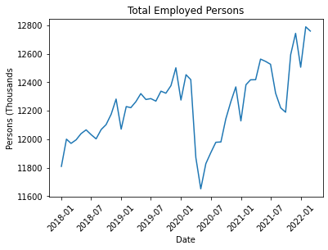
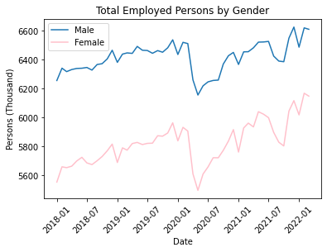
Employment Activity
Lockdown Started on
13 March 2020
766K people became unemployed
356K men and 410K women

Slide 4
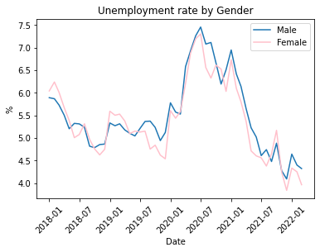

Unemployment rate
Current unemployment rate is even lower than pre-COVID

Slide 5
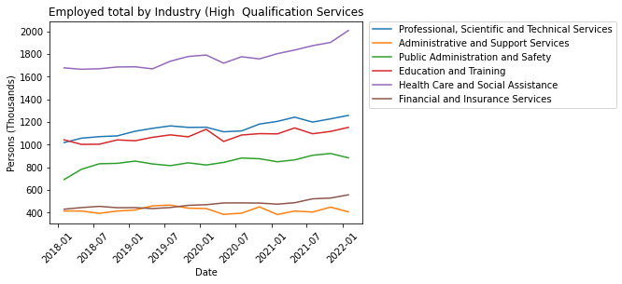

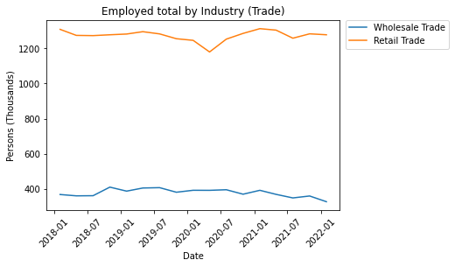

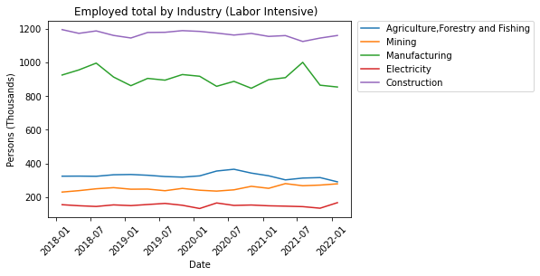
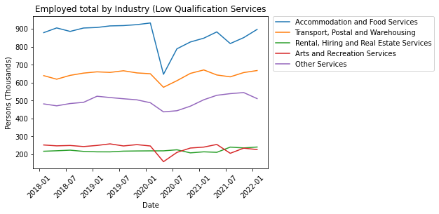
Employment by Industry
Accommodation and arts services
High skilled jobs
Health care increase occupation

Slide 6
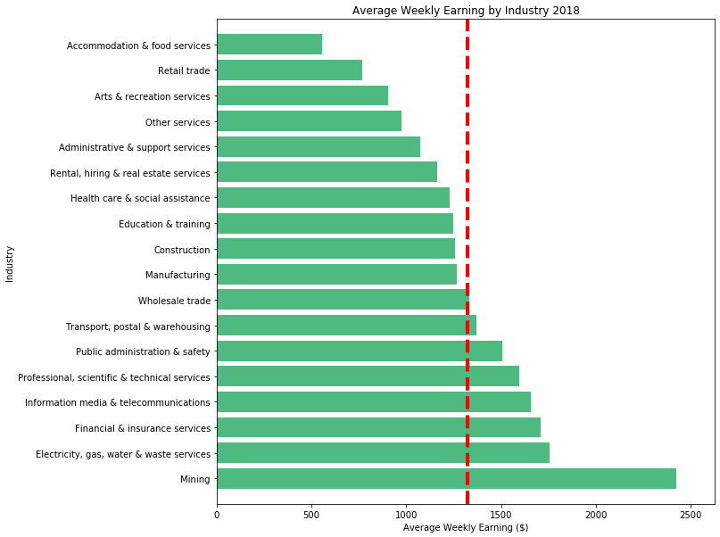
Average Weekly Earning
2018 (Half year ended Nov 18)
Average
Weekly
Earning
$1,322.58
Hotel/FS is $767
Retails is $553
Mining is $1,104

Slide 7
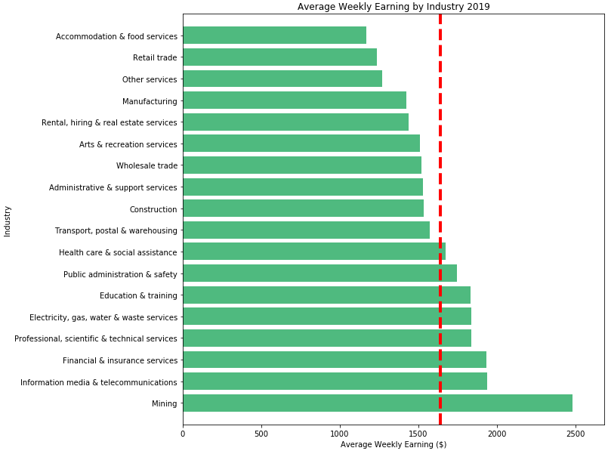
Average Weekly Earning
2019 (Half year ended Nov 18)
Average
Weekly
Earning
$1,638.81
Hotel/FS is $468
Retails is $402
Mining is $846

Slide 8
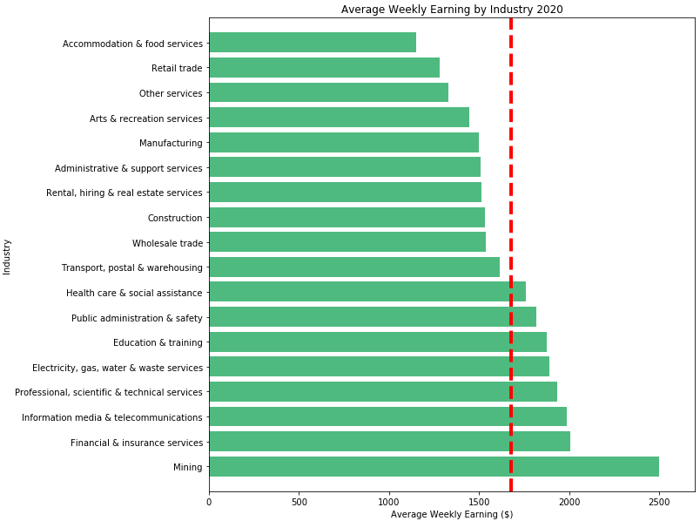
Average Weekly Earning
2020 (Half year ended Nov 18)
Average
Weekly
Earning
$1,675.32
Hotel/FS is $527.42
Retails is $397
Mining is $821

Slide 9
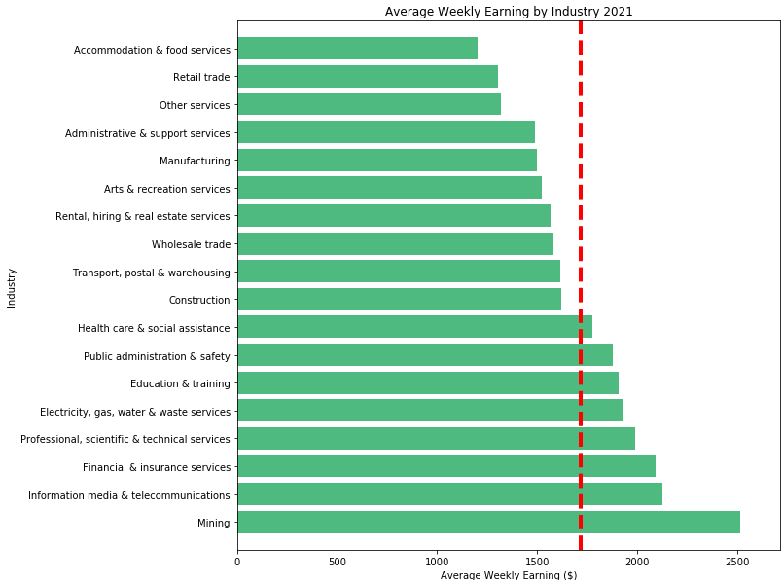
Average Weekly Earning
2021 (Half year ended Nov 18)
Average
Weekly
Earning
$1,718.98
Hotel/FS is $514
Retails is $416
Mining is $821

Slide 10
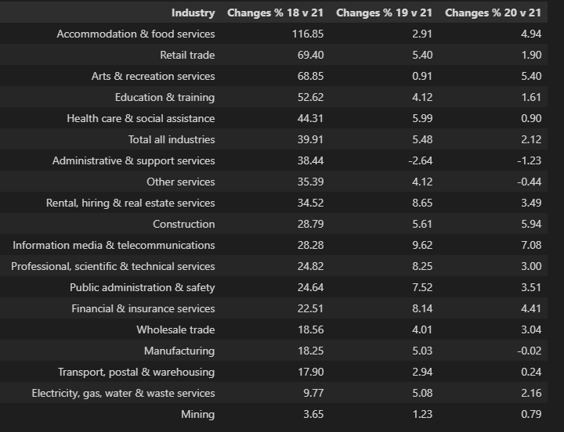
2018 -2021 Average Weekly Earning Changes (%)
Top 5 Industries: unchanged 2018-2021
1.Mining
2.Financial & Insurance Service
3.Information media & Telecommunications
4.Professional, scientific & Tech Services
5.Educationi & Training
Bottom 5 Industries: unchanged 2018-2021
1.Accommodation & Food Services
2.Retails Services
3.Other Services
4.Art & recreation services
5.Admin and Support services

Slide 11
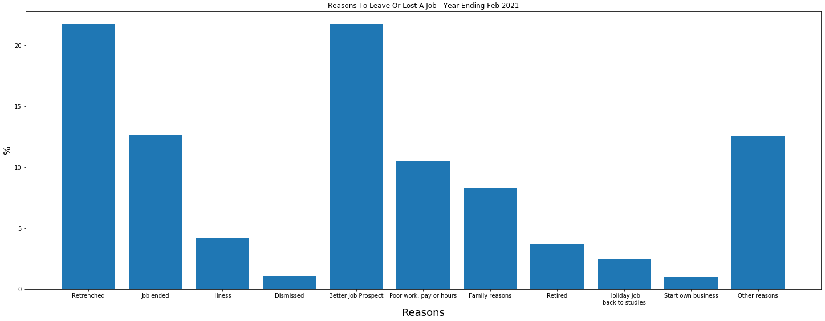
Reasons People Moved During Covid

Slide 12
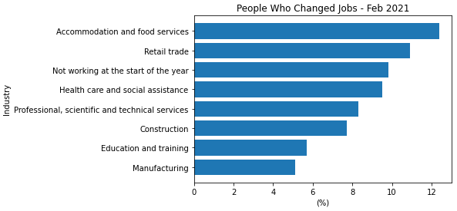
Changing Jobs
Data is from ABS - Job Mobility (Year Ending February 2021)
This figure shows that 12% of those working under Accommodation and Food Services decided to change jobs, next was Retail which was 11% and Health Care was 9.5%.

Slide 13
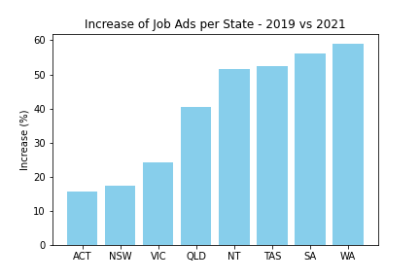
Job Ads by State
Internet Vacancy Index (IVI) which is a monthly count of online job advertisements compiled by the National Skills Commission through job boards such as Seek, CareerOne and Australian JobSearch. (https://labourmarketinsights.gov.au/our-research/internet-vacancy-index/#3)
Comparing the total vacancies between 2019 vs 2021, Western Australia had a growth of 59%.

Slide 14
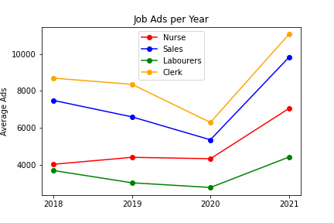
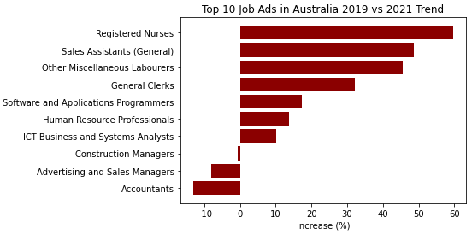
Job Ads
Below are the top 10 job roles with the most job advertisements across Australia.
Looking between 2019 and 2021, Registered Nurses (59%), Sales Assistants (48%), Labourers (45%) and General Clerks (32%) are the job roles that had a significant increase.

Slide 15
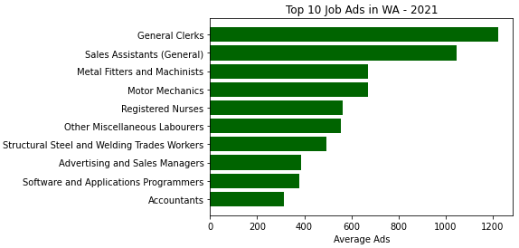
Job Ads in Western Australia
Occupations with the most job ads in WA are General Clerks (1200), Sales Assistants (1050), Metal Fitters and Machinists (670).

Slide 16
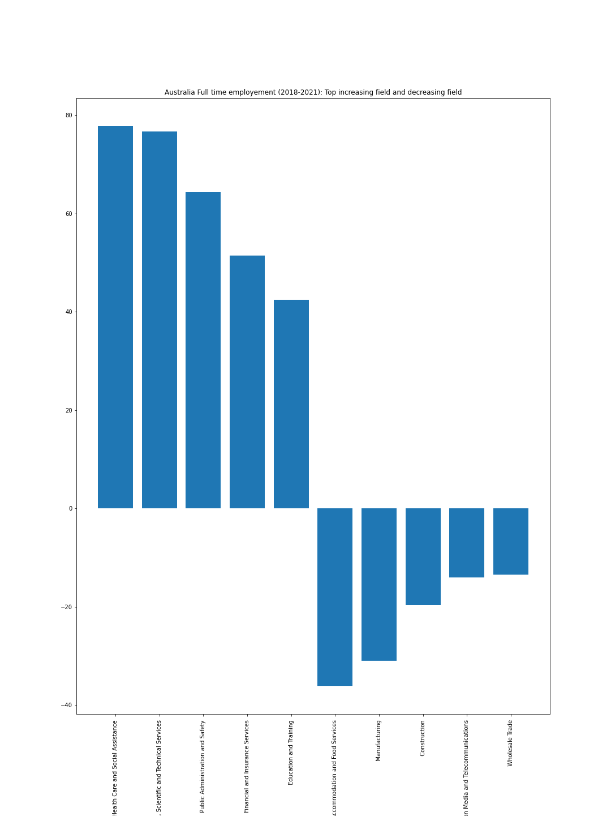
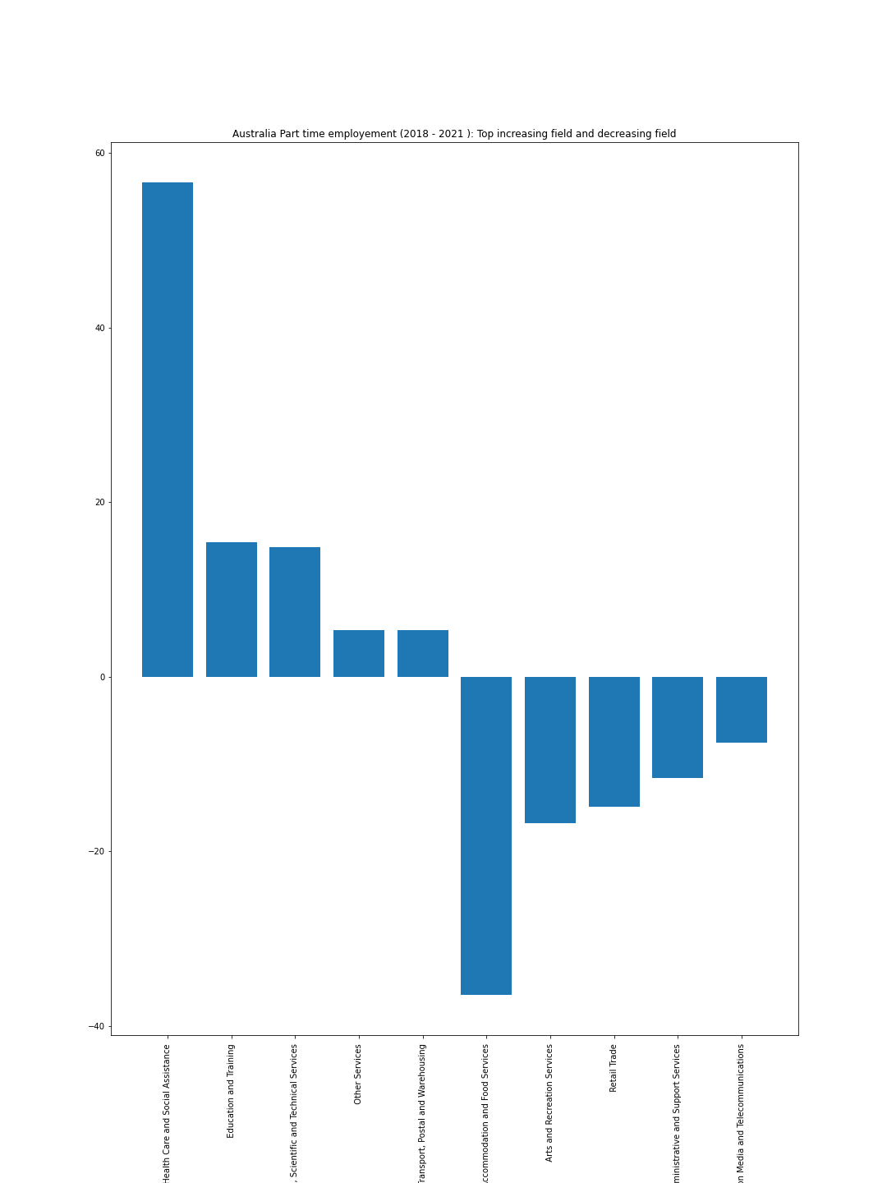
Australian FT vs PT Employment
Top 5
Health Care +77.79
Professional, Scientific and Technical Services +76.70
Public Administration & Safety +64.35
Financial Insurance Services +51.39
Education and Training +42.42
Top 5
Health Care 56.63
Education +15.45
Professional, Scientific and Technical Services +14.82
Other +5.4
Transport + 5.39
Bottom 5
Accommodation & Food Services -36.38
Arts and Recreation Services -15.45
Retail -14.92
Administrative and Support Services -11.53
Information Media and Telecommunications – 7.56
Bottom 5
Accommodation & Food Services -36.13
Manufacturing -30.95
Construction -19.71
Information Media and Telecommunications -14.05
Wholesale -13.45

Slide 17
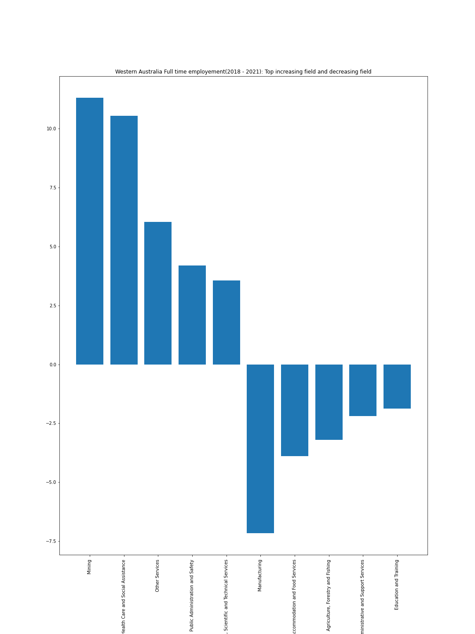
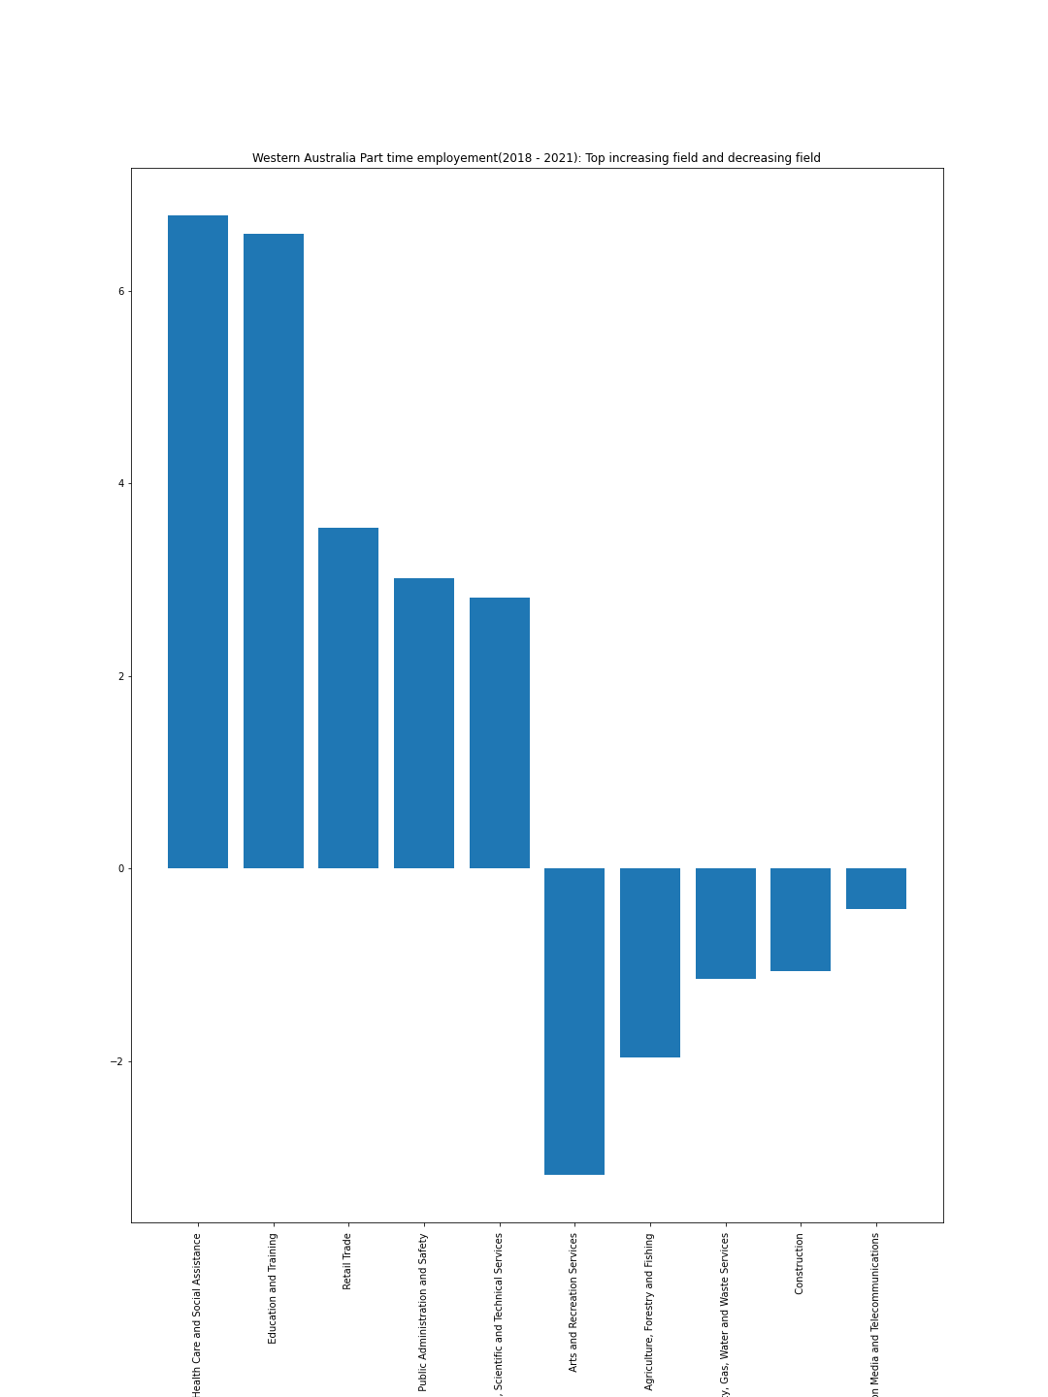
WA FT vs PT Employment
Top 5
Mining +11.29
Health Care +10.54
Other +6.02
Public Administration and Safety +4.19
Professional, Scientific and Technical Services +3.54
Top 5
Health Care +6.78
Education and Training +6.59
Retail +3.53
Public Administration and Safety +3.01
Professional, Scientific and Technical Services +2.80
Bottom 5
Manufacturing -7.14
Accommodation and Food Services -3.89
Agriculture, Forestry and Fishing -3.19
Administrative and Support Services -2.18
Education and Training -1.87
Bottom 5
Arts & Recreation -3.17
Agriculture, Forestry and Fishing -1.96
Electricity, Gas, Water and Waste Services -1.14
Construction -1.06
Information Media and Telecommunication -0.42

Slide 18
Summary
COVID initially had a negative impact on overall employment in 2020 when lockdowns and border restrictions happened. Most industries slowed down, employees were either retrenched or stood down and some businesses closed or were operating on less hours.
Based on the employment rate, average weekly earnings and job vacancies available, we have seen that COVID had negative impact on certain industries, positive on other industries while others remained stable.
Data is showing that employment rate and majority of the industries are performing better currently than before.
COVID has triggered people to re-evaluate their current role and employment status. Some are wanting more flexibility and moving from full-time to part-time. Due to limited data, we are unable to determine industries/roles offering hybrid working arrangement and if more people prefer this setting.
For someone who has been thinking of moving in the next 6 to 12 months, now is a good time to explore opportunities available.
For those who might already be in a well-performing or stable industry, there is an opportunity to assess your remuneration and compare it with the current market.

